Slide 1
Trade Model Bayesian Approach
ABC= Approximate Bayesian Computation
Notes:
Simple, but computer capacity demanding

Slide 2
Dual (legal/illegal) wildlife trading
Restrictions on natural resource use can create dual markets of legal/illegal products
Restrictions can distort competition in markets, creating price differences between legal and illegal products
There has been advances in understanding how these restrictions affect markets or harvesters
Important gaps in our understanding of traders* economic incentives for trading legal or illegal products
Notes:
restrictions such as sanitary, conservation, quotas
because of maintained demand that is not met by legal products (Size of the legal market (0=ban)
Even if traded in the same place
Most of the work so far is conceptual with little data
Or a mix of both, what determines this mix

Slide 3

Case study adaptation of the model: Hake small-scale fishery in Chile
Fishery of great social, ecological and economic importance in Chile
High levels of non-compliance reported for quota: translates into dual trading (legal/illegal)
Fix numbers of traders
Trading occurs from port to fishing terminal in
Santiago
Government enforcement on highways
Notes:
Fishery Employs over 10,000 people directly
Simple system to model
no possibility for new entries (closed system)

Slide 4
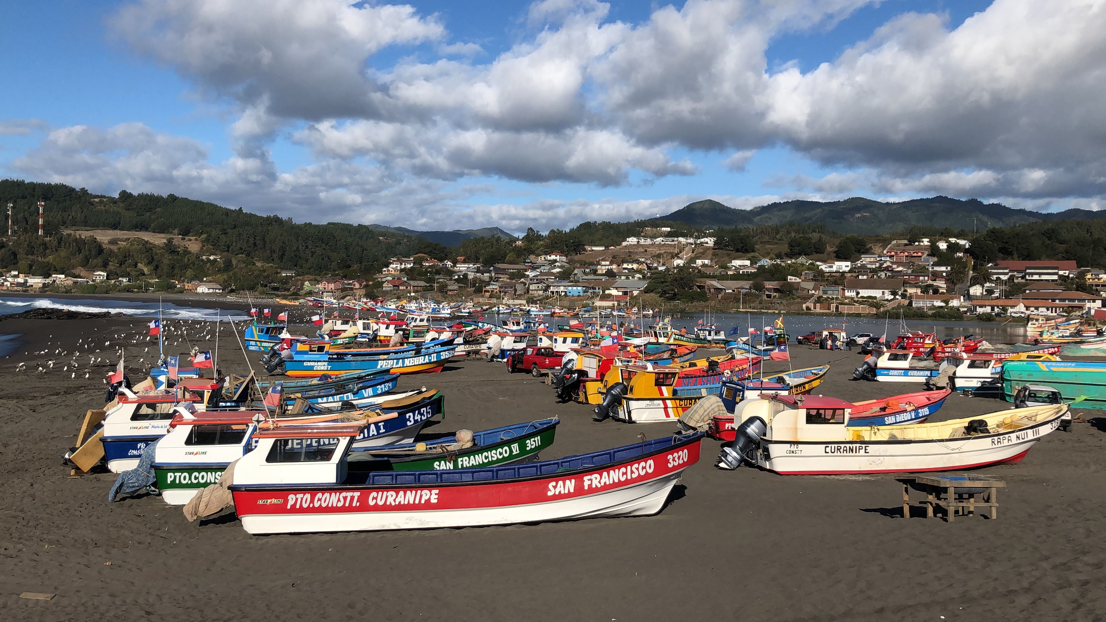

Slide 5
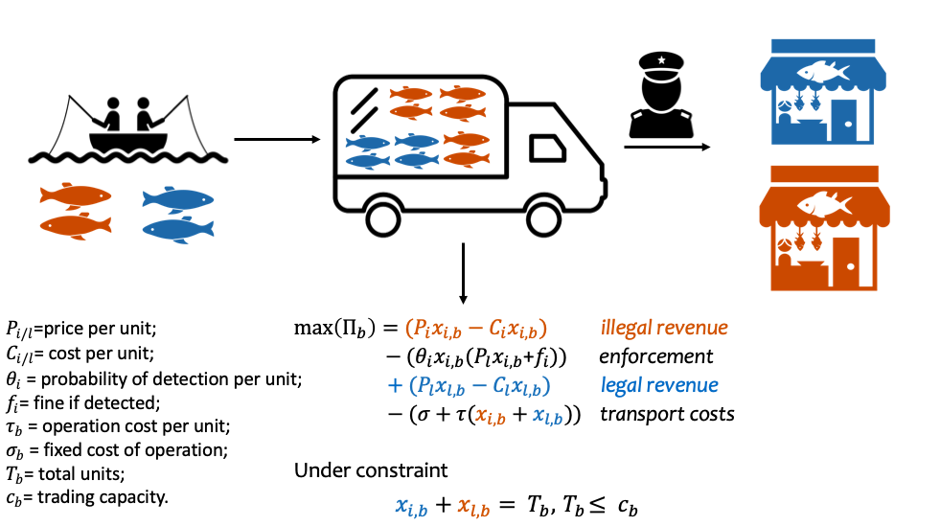
Figure 1. Schematic representation of the general, static form of the model.

Slide 6
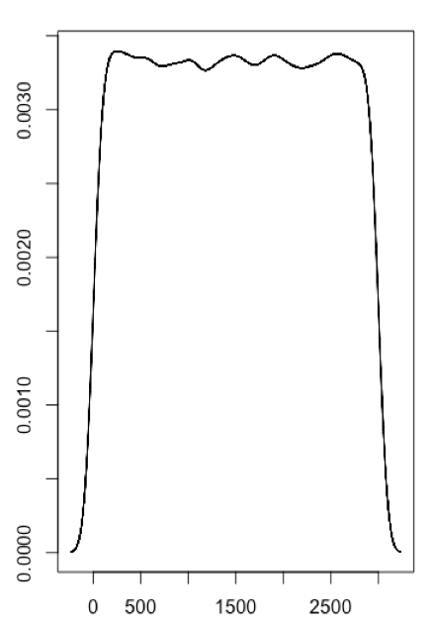
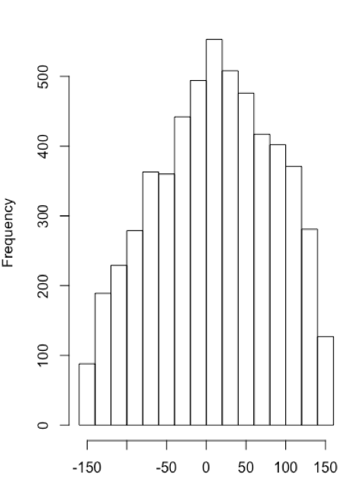
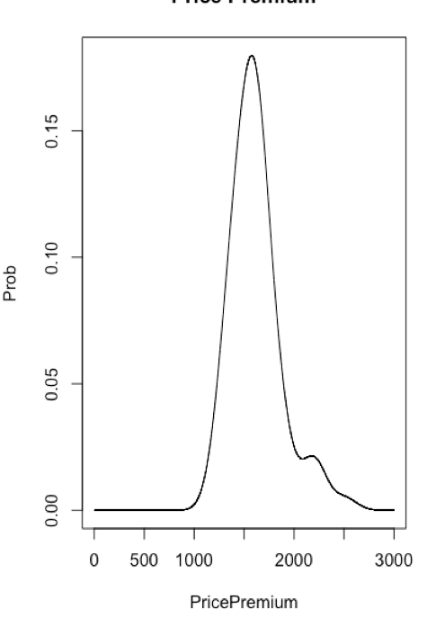
2-step ABC
Non- informative priors for: unknown (illegal) parameters
Prior
Draw
Generic Model
(with known (legal) parameters)
1
Output: Comparison to data
(% diff with quota)
Filter (±10%) and select values from prior, to build posterior
Filter
*can repeat/update this whole process
Notes:
high uncertainty/variability
Priors are these parameter with non-informed distribution within a range, that comes from different sources
Model is the generic model, no time no truck variability
Posterior built is a better approximation of parameter distribution
non-inf=Price Premium, Detectability, Total Landings

Slide 7
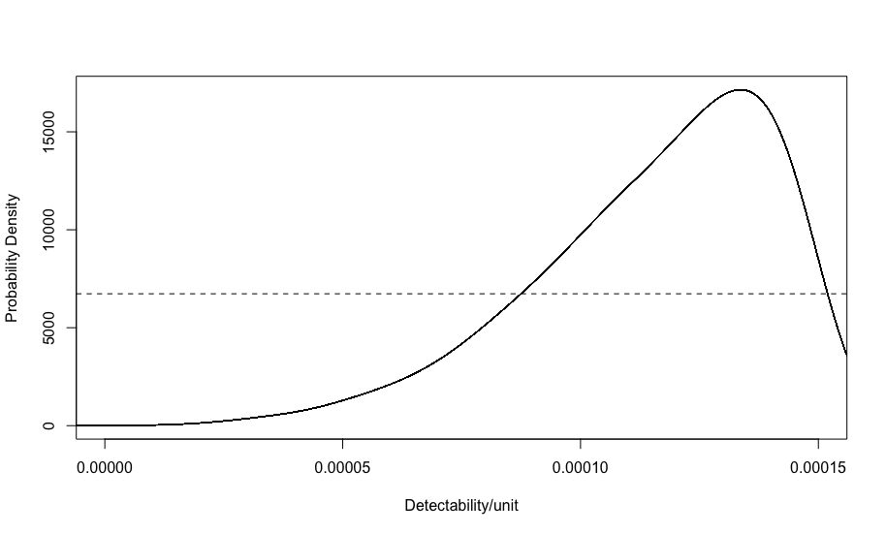
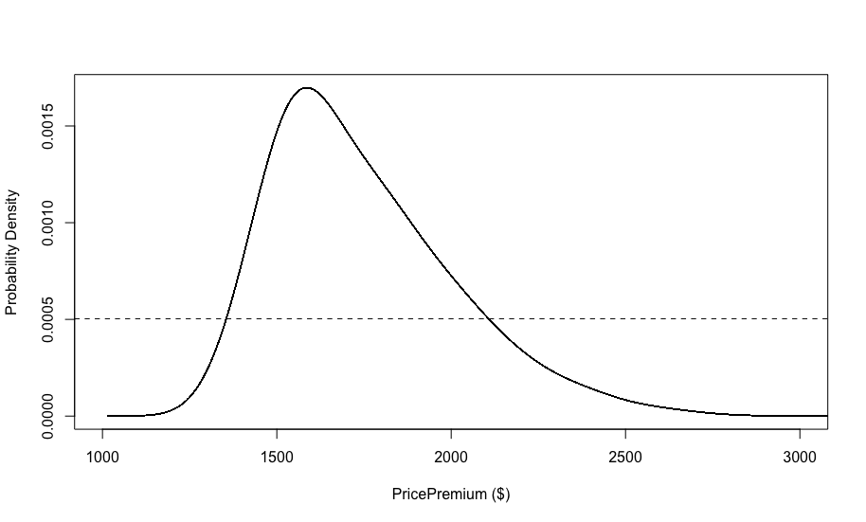

Slide 8
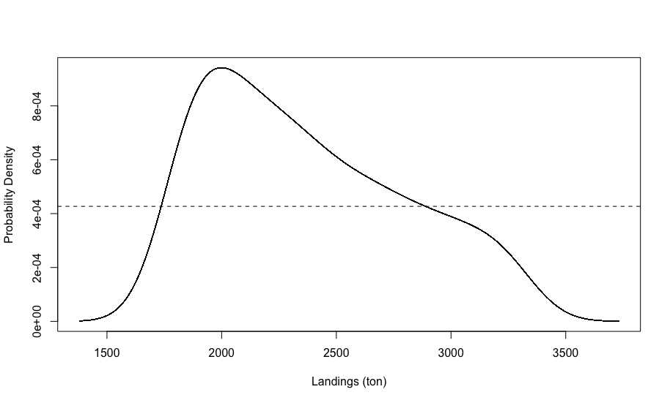

Slide 9
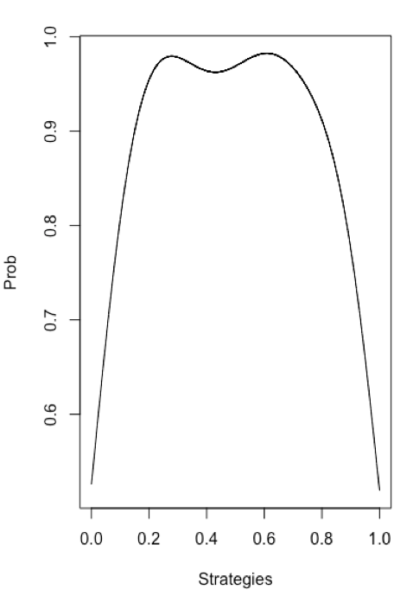
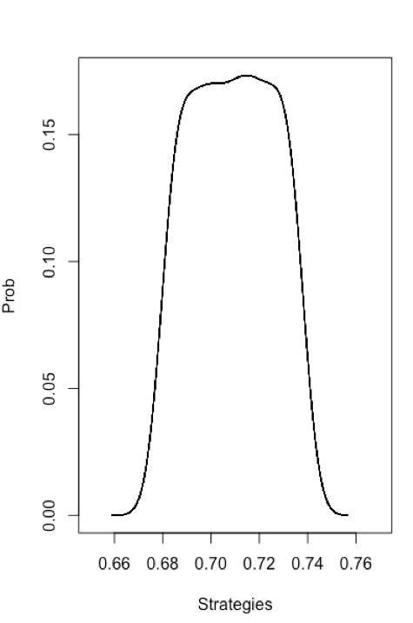
2-step ABC
Non- informative priors for:
Set of strategies
Prior
Complete Model
(known parameters and PDFs generated in step 1 to account for variability in each time step)
Draw
2
Output Comparison to data
(% diff with quota)
Filter (±10%) and Select values from prior, to build posterior of sets of strategies
Filter
Notes:
Strategy is the ratio a truck will choose in each time period
For now is only 1 strategy
Model is the “complex” one in which there is time and truck variability. Parameter distribution data is used as variability in each time step

Slide 10
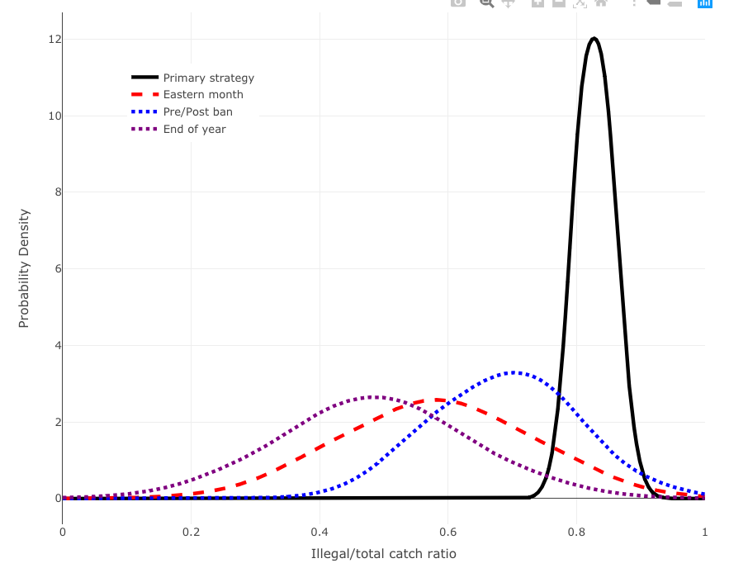

Slide 11
